Slide 1
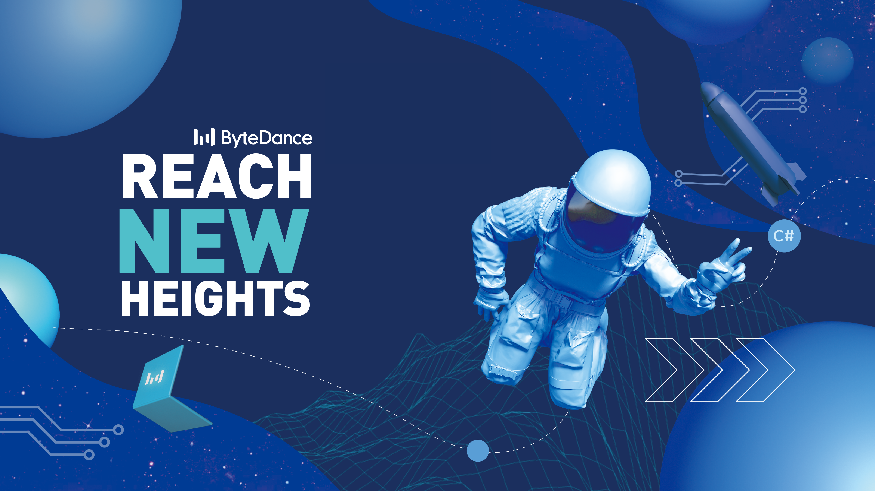
REACH
NEW
HEIGHTS

Slide 2
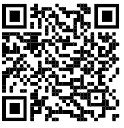
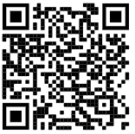
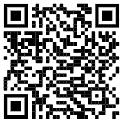
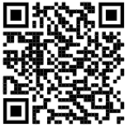
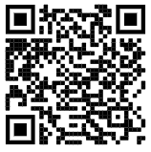
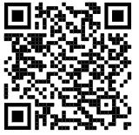
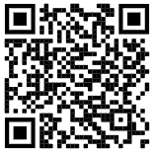
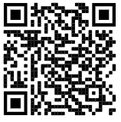
Our Positions - Singapore
Algorithm Engineer, Computer Vision
Computer Vision Engineer
Computer Vision Scientist
How to apply?
Option 1: QR Code
Please scan the QR code to apply for the role you are interested in.
Option 2: Contact HR
Sherry.wen@bytedance.com
Email Subject:
Position Name + Research Area + City
NLP Scientist
NLP Engineer
Software Engineer, Cloud Data Warehouse
C++ Engineer, Data Platform
Software Engineer, Ad Data
Notes:
- a customizable path
- highly competent teams
- global experience
- courageous mindsets
- a proud product portfolio
Here at ByteDance having it be one of the fastest growing platform in the world, we are moving at fast rate.

Slide 3
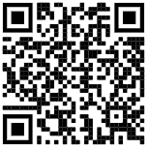
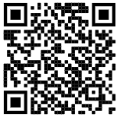
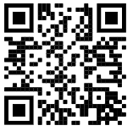
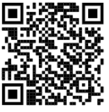
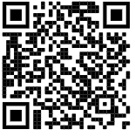
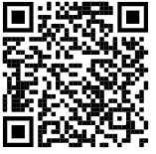
How to apply?
Option 1: QR Code
Please scan the QR code to apply for the role you are interested in.
Option 2: Contact HR
NLP, ML Systems, Deep
lab-hr@bytedance.com
Reinforcement Learning, SLAM & 3D Vision
jingmeijun@bytedance.com
TikTok
xingne@bytedance.com
Big Data
songdonghua@bytedance.com
Ads Tech
sunchengcheng@bytedance.com
Applied Machine Learning (AML)
Xutianqi@bytedance.com
Xigua Video
jiangying.0506@bytedance.com
Email Subject:
Position Name + Research Area/Team + City
Our Positions – Beijing (1/2)
Algorithm Engineer, AML
ML Platform Engineer, AML
Product Manager, Xigua Video
Algorithm Engineer, Ads Tech
Engineer, Infrastructure, Ads Tech
Big Data Engineer
Notes:
- a customizable path
- highly competent teams
- global experience
- courageous mindsets
- a proud product portfolio
Here at ByteDance having it be one of the fastest growing platform in the world, we are moving at fast rate.

Slide 4
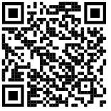
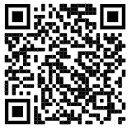
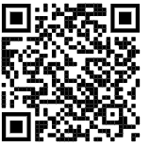
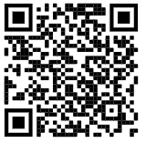
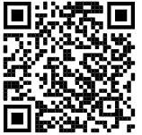
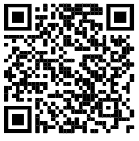
How to apply?
Option 1: QR Code
Please scan the QR code to apply for the role you are interested in.
Option 2: Contact HR
NLP, ML Systems, Deep
lab-hr@bytedance.com
Reinforcement Learning, SLAM & 3D Vision
jingmeijun@bytedance.com
TikTok
xingne@bytedance.com
Big Data
songdonghua@bytedance.com
Ads Tech
sunchengcheng@bytedance.com
Applied Machine Learning
Xutianqi@bytedance.com
Xigua Video
jiangying.0506@bytedance.com
Email Subject:
Position Name + Research Area/Team + City
Our Positions – Beijing (2/2)
Algorithm Engineer, NLP
3D Algorithm Engineer, Computer Vision
Software Engineer, ML Systems
Software Engineer, Machine Learning, TikTok
Software Engineer, Ranking, TikTok
Researcher, Deep Reinforcement Learning
Notes:
- a customizable path
- highly competent teams
- global experience
- courageous mindsets
- a proud product portfolio
Here at ByteDance having it be one of the fastest growing platform in the world, we are moving at fast rate.

Slide 5
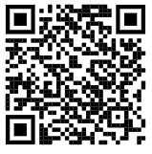
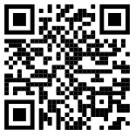
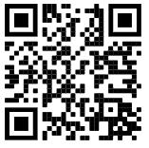
Our Positions – Xiamen | Shenzhen
Shenzhen
How to apply?
Option 1: QR Code
Please scan the QR code to apply for the role you are interested in.
Option 2: Contact HR
Shenzhen
wangjingting@bytedance.com
Xiamen
qiuyang@bytedance.com
Email Subject:
Position Name + Research Area + City
Algorithm Engineer, Computer Vision
Reinforcement Learning Researcher
Algorithm Engineer, Ads
Xiamen
Vedio User Operations, Xigua Video
Notes:
- a customizable path
- highly competent teams
- global experience
- courageous mindsets
- a proud product portfolio
Here at ByteDance having it be one of the fastest growing platform in the world, we are moving at fast rate.

Slide 6
Recruiting Notes
Job Categories
R&D, Product, Design, Sales & Marketing, Operations, Functional Support, and many more
Target Group
Full-time: class of 2020 graduates
(Graduation time: 2019.9-2020.8)
Summer Intern: class of 2021 graduates (Graduation time: After 2020.8)
Recruiting Process
Work Location
Beijing, Shanghai, Shenzhen, Chengdu, Mountain View, Seattle, Singapore, London, Mumbai and more

Slide 7
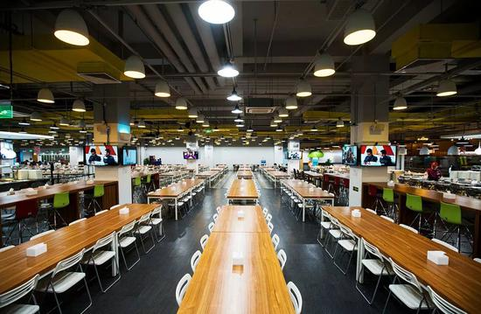
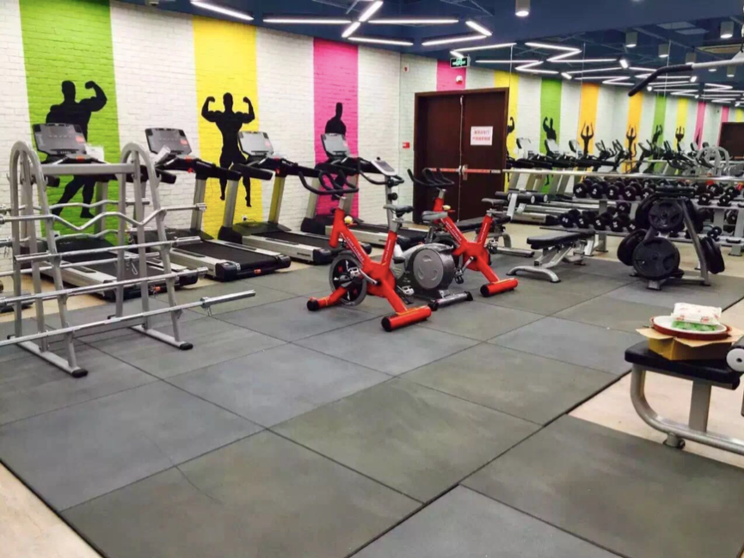
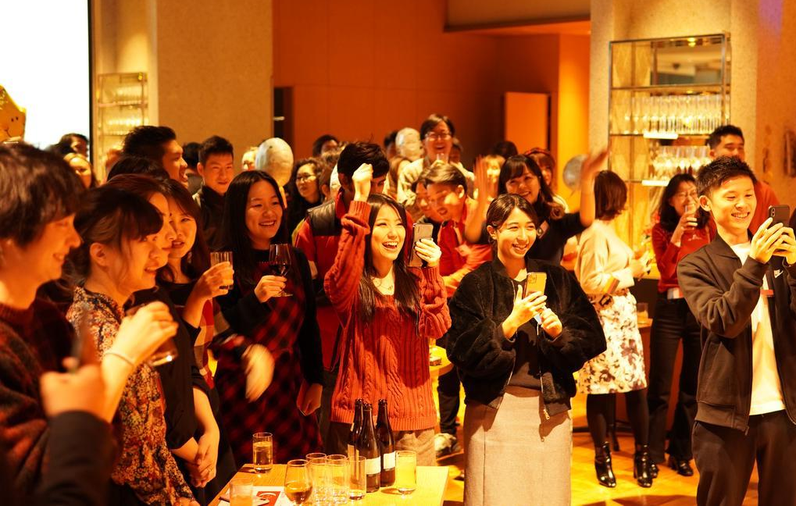
Working Environment
Notes:
Pic1: Office
Pic2: Gym
Pic3: Canteen
Pic4: New year party
Pic middle: food

Slide 8
Thanks!
C#
Scan QR code to join the ByteDance Q & A group

